Slide 1
🍴 ZOMATO
Zomato Restaurant Expansion
Analysis Report
Strategic Market Insights | Global Expansion Study | Data-Driven Recommendations
9,551
15
2.89
156.9
Restaurants
Countries
Avg Rating
Avg Votes
Prepared by: Sonal Bhosale | Data Science Feb 2026 Batch

Slide 2
INTRODUCTION & OBJECTIVES
💡 Did You Know? Zomato began in 2008 as “Foodiebay,” a simple website for browsing restaurant menus. It later transformed into a global food delivery platform handling millions of orders daily.
PROJECT CONTEXT
KEY OBJECTIVES
This project performs a comprehensive Excel-based analysis of Zomato's global restaurant dataset spanning 2010–2018.
The dataset contains 20+ attributes including ratings, votes, cuisine types, pricing, and delivery features across 15 countries.
Pivot tables, VLOOKUP, conditional formatting, and array formulas were utilized to derive insights.
Identify potential markets for expansion
Analyse restaurant quality & competition
Evaluate customer spending patterns
Study cuisine preferences & ratings correlation
Recommend cities, pricing & service models

Slide 3
DATA OVERVIEW
📊
📋
🗃️
📅
2
20+
9,551
2010–18
Tables
Attributes
Records
Time Range
Raw Data + Country Description
14 Categorical, 6 Continuous
Across 15 Countries
9 years of data
DATA CLEANING STEPS
Missing Values
VLOOKUP for Country
Identified blanks using 'Go to Special'; filled Cuisines column with 'Unknown' for null entries.
Matched Country Code to Country Name using =VLOOKUP('Raw Data'!C2,'country description'!A:B,2,FALSE).
Date Formatting
Currency Symbol Column
Converted date format using DATEVALUE(SUBSTITUTE(T2,"_","-")) to extract proper year values.
Created custom price column by concatenating currency abbreviation + Average Cost for Two.

Slide 4
METHODOLOGY
TOOLS & TECHNIQUES
ANALYTICAL APPROACH
Pivot Tables
1
Data Cleaning
Country, city, price, rating aggregation
Handle nulls, fix dates, enrich with country names
VLOOKUP / XLOOKUP
Merging country descriptions
2
Objective Analysis
Answer factual questions using pivot & formulas
SUMPRODUCT / Array
Multi-condition counting & filtering
3
Competitive Mapping
Conditional Formatting
Restaurant count, avg rating, avg votes per market
Highlighting recommended countries
IF + Logical Ops
4
Segmentation
Rating classification: Poor/Average/Good/Excellent
Price range distribution, rating quality brackets
String Operations
5
Recommendation
CONCATENATE + FIND for currency col
Data-driven city & strategy suggestions

Slide 5
RESTAURANT DISTRIBUTION
📌 Analysis: India dominates with 8,652 restaurants (~91% of total), followed by the USA and UAE. This heavy concentration suggests Zomato's expansion opportunity lies significantly outside India, where market penetration remains low despite strong global dining demand.

Slide 6
RESTAURANT GROWTH
📌 Analysis: Restaurant listings grew steadily from 2010, peaking around 2017–2018, indicating rapid platform adoption. The growth curve reflects Zomato's aggressive onboarding strategy, though year-on-year slowdowns in later years may signal market saturation in core geographies.

Slide 7
RATINGS
📌 Analysis: Most restaurants cluster in the 2.5–3.5 rating range, with relatively few achieving scores above 4.0. This highlights a quality gap in the market — a major opportunity for Zomato to curate and promote higher-quality restaurant partners.

Slide 8
VOTES
📌 Analysis: Vote counts are highly skewed. This suggests strong brand loyalty concentration, meaning new entrants must invest heavily in visibility and customer engagement to break through.

Slide 9
TOP 10 CUISINES
📌 Analysis: Healthy and diverse cuisines like Mexican, American & Healthy Food (India) and Continental, Middle Eastern & Asian (India) score 4.9 and 4.8 respectively, reflecting a growing global appetite for varied, health-conscious options. Meanwhile, comfort and casual foods like Bar Food, Burgers & Steak (USA) and Bar Food (Turkey) both score 4.9, showing that indulgent, crowd-pleasing cuisines remain equally dominant in customer satisfaction.

Slide 10
IMPACT OF ONLINE DELIVERY AND ONLINE BOOKINGS ON RATINGS
📌 Analysis: Restaurants offering both online delivery and table booking achieve the highest average rating (3.60), while those offering neither score only 2.68. This clear performance gap confirms that adopting a full digital service model is critical to competitive success.

Slide 11
AVERAGE COST OF TWO
📌 Analysis: Average cost for two varies dramatically by country — from budget-friendly markets like India and Turkey to premium markets like New Zealand and Philippines. Pricing strategy must be localised, with higher price points correlating to better perceived quality and ratings.

Slide 12
PRICE RANGE BY COUNTRY
📌 Analysis: Price Range 1 (cheap) dominates across most countries, but markets like South Africa and New Zealand show a strong lean toward mid-to-premium pricing. Restaurants at Price Range 3–4 consistently earn higher ratings, reinforcing a premium positioning strategy for expansion.

Slide 13
FOCUSED ANALYSIS ON THE RECOMMMENDED COUNTRIES – OVERVIEW
OVERVIEW OF NEXT 7 SLIDES
01
05
MARKET SELECTION: WHERE TO EXPAND?
COMPETITIVE LANDSCAPE IN TARGET MARKETS
02
06
CITY RECOMMENDATIONS BY COUNTRY
CUISINE STRATEGY & SERVICE MODEL
03
07
CURRENT QUALITY RATINGS IN TARGET MARKETS
PRICING STRATEGY: CORRELATION & DISTRIBUTION
04
FOOD EXPENDITURE IN TARGET MARKETS

Slide 14
MARKET SELECTION: WHERE TO EXPAND?
PRIMARY
PRIMARY
SECONDARY
SECONDARY
SECONDARY
#1
#2
#3
#4
#5
🇵🇭
🇮🇩
🇹🇷
🇳🇿
🇿🇦
Philippines
Indonesia
Turkey
New Zealand
South Africa
RESTAURANTS
RESTAURANTS
RESTAURANTS
RESTAURANTS
RESTAURANTS
22
21
34
40
60
AVG RATING
AVG RATING
AVG RATING
AVG RATING
AVG RATING
4.47
4.30
4.30
4.26
4.21
AVG VOTES
AVG VOTES
AVG VOTES
AVG VOTES
AVG VOTES
407
772
431
243
315
📌 APPROACH: Restaurant count (saturation) × Avg Rating (quality signal) × Avg Votes (demand signal). Countries excluded: Canada (low votes=103, rating=3.58) and Singapore (votes=32). Excluded because despite low competition, demand signal is weak.

Slide 15
CITY RECOMMENDATIONS BY COUNTRY
🇵🇭 Philippines
PRIMARY
🇳🇿 New Zealand
SECONDARY
Makati City (4.65 ⭐, 452 votes)
Auckland (4.28 ⭐, 340 votes)
Pasig City (4.63 ⭐, 697 votes)
Wellington City (4.25 ⭐, 146 votes)
Taguig City (4.53 ⭐, 416 votes)
🇮🇩 Indonesia
PRIMARY
🇿🇦 South Africa
SECONDARY
Jakarta (4.36 ⭐ , 743 votes)
Inner City Johannesburg (4.90 ⭐ — HIGHEST RATED)
Tangerang (4.30 ⭐, 1,184 votes – HIGHEST UNMET DEMAND)
Sandton (4.30 ⭐, 492 votes)
Bandung (4.20 ⭐)
Cape Town (4.11 ⭐)
🇹🇷 Turkey
SECONDARY
İstanbul (4.29 ⭐, 860 votes)
Ankara (4.30 ⭐, 131 votes)

Slide 16
CURRENT QUALITY RATINGS IN TARGET MARKETS
📌 Philippines leads with 95.5% excellent ratings. The competitive bar is very high — new entries must aim for ratings above 4.0 to compete effectively.
Philippines 🇵🇭
96%
95.5% Excellent
New Zealand 🇳🇿
93%
92.5% Excellent
Turkey 🇹🇷
88%
88.2% Excellent
Indonesia 🇮🇩
81%
14%
81% Excellent
South Africa 🇿🇦
78%
20%
78.3% Excellent
Excellent (≥4.0)
Good (3.5-3.9)
Average (3.0-3.4)
Poor (<3.0)

Slide 17
FOOD EXPENDITURE IN TARGET MARKETS
💰
Turkey 🇹🇷
Total Spend (INR)
BUDGET-FRIENDLY
₹7,501
Avg Price Range: 2.82 / 4
💰
Indonesia 🇮🇩
Total Spend (INR)
BUDGET-FRIENDLY
₹30,706
Avg Price Range: 2.95 / 4
💵
South Africa 🇿🇦
Total Spend (INR)
MODERATE
₹1,15,846
Avg Price Range: 3.58 / 4
💵
New Zealand 🇳🇿
Total Spend (INR)
MODERATE
₹1,42,290
Avg Price Range: 3.15 / 4
💸
Philippines 🇵🇭
Total Spend (INR)
PREMIUM
₹2,15,635
Avg Price Range: 3.36 / 4

Slide 18
COMPETITIVE LANDSCAPE IN TARGET MARKETS
TOP COMPETITORS (Rating ≥ 4.5)
LOW-RATED RESTAURANTS (Below 3.0 – Opportunity)
Talaga Sampireun
⭐ 4.9 | 1,838 votes
De Fontein Belgian Beer Cafe
New Zealand 🇳🇿 | Rating: 2.3 | 402 votes
This is the ONLY sub-3.0 restaurant across all 5 recommended markets — confirming the overwhelmingly high-quality competitive environment.
Indonesia 🇮🇩
Multiple locations, major chain!
Starbucks
⭐ 4.9 | 1,042 votes
Turkey 🇹🇷
Premium café segment leader
J'adore Chocolatier
⭐ 4.7 | 1,311 votes
STRATEGIC INSIGHT
Turkey 🇹🇷
Dessert & café concept
Study Talaga Sampireun's multi-location model in Indonesia
Toodz House
⭐ 4.6 | 1,476 votes
Silantro Fil-Mex & Ooma are high-traffic in Philippines
Indonesia 🇮🇩
High-volume outlet
Market leaves little room for low-quality offerings
Focus on premium quality to survive in these markets

Slide 19
CUISINE STRATEGY & SERVICE MODEL
RECOMMENDED CUISINES
ONLINE DELIVERY & TABLE BOOKING IMPACT
⭐4.9
Sunda / Indonesian
Table Booking
Online Delivery
Avg Rating
Indonesia | Highest demand — local advantage
YES
YES
3.60
BEST OUTCOME
⭐4.9
Bar Food
Turkey | Istanbul specialty
YES
NO
3.22
TABLE BOOKING DRIVES QUALITY
⭐4.6
Desserts & Bakery
NO
YES
3.41
DELIVERY HELPS TOO
Indonesia | Cross-market appeal
⭐4.6
Cafe / Fusion
NO
NO
2.68
LOWEST RATED
NZ / PH | Urban positioning
⭐4.5+
Italian / European
Multi | Premium segment
✅ RECOMMENDATION: Implement BOTH online delivery AND table booking. The combination yields the highest avg rating of 3.60 vs. 2.68 for neither.

Slide 20
PRICING STRATEGY: CORRELATION & DISTRIBUTION
Price Range vs Average Rating (Positive Correlation)
Price Distribution: Target Markets
1 – Cheap
South Africa
28%
65%
Premium-heavy
4,444 restaurants | Avg Cost: ₹275
⭐ 2.38
Philippines
55%
40%
Mid-premium
2 – Moderate
3,113 restaurants | Avg Cost: ₹597
⭐ 3.07
Indonesia
95%
Mid-premium dom.
3 – Expensive
1,408 restaurants | Avg Cost: ₹5,177
New Zealand
42%
40%
⭐ 3.71
Balanced
4 – Very Exp.
Turkey
32%
53%
Mid-range
586 restaurants | Avg Cost: ₹1,849
⭐ 3.84
📌 PRICING RECOMMENDATION: Position in Price Range 3–4 (Expensive/Very Expensive). Clear positive correlation — higher price = better perceived quality and ratings.

Slide 21
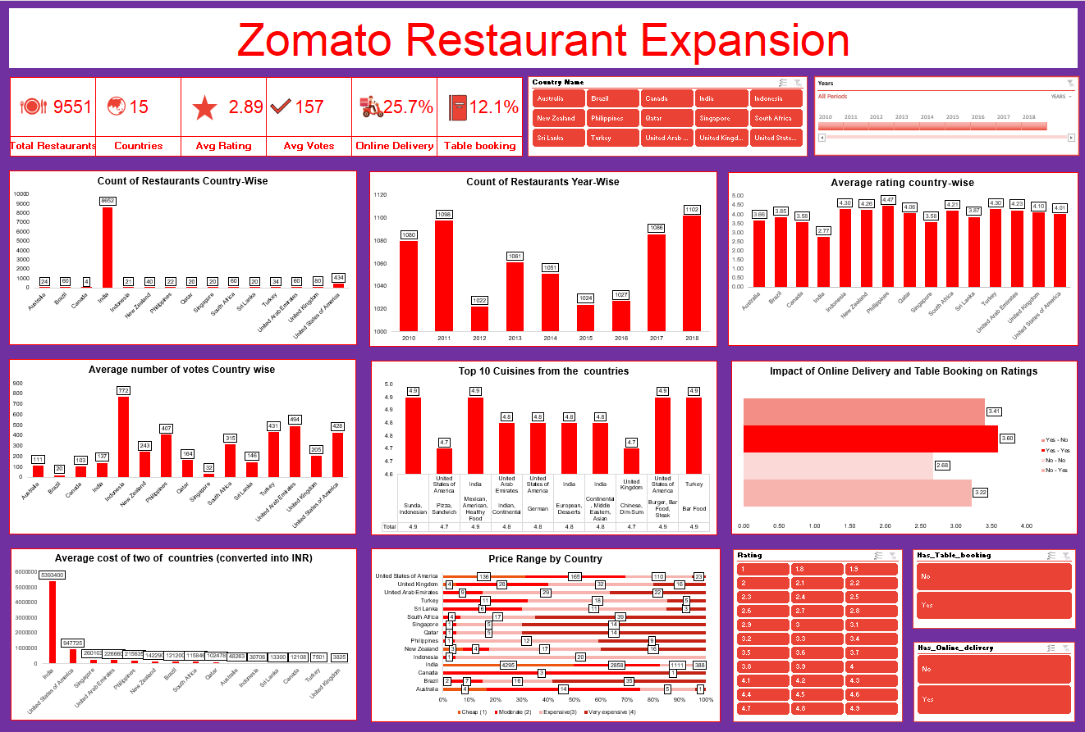
DASHBOARD OVERVIEW & KEY METRICS
📊 Full interactive dashboard with dynamic slicers available in the Excel workbook — filter by country, price range, year, cuisine, delivery/booking status.

Slide 22
CONCLUSION & STRATEGIC RECOMMENDATIONS
01
Priorities Philippines & Indonesia
04
Service Model: Both Delivery & Table Booking
Lowest competition, highest ratings (4.47 & 4.30), and strongest vote counts signal extremely high unmet demand. Enter with Sunda cuisine in Jakarta & Makati City.
Restaurants offering BOTH features achieve avg rating 3.60 vs 2.68 for neither. Full digital service adoption is non-negotiable.
02
Turkey & New Zealand as Secondary Markets
05
Cuisine & Pricing Formula
Istanbul (860 avg votes) and Auckland (340 avg votes) offer excellent quality benchmarks with room for new premium entrants. Price Range 3–4 recommended.
Focus on local/regional cuisines + fusion concepts + desserts. Maintain Price Range 3+ — clear correlation shows higher pricing = better perceived quality.
03
South Africa for Premium Segment
Inner City Johannesburg has 4.90 avg rating with very low competition. Position as a premium restaurant in the Sandton/Johannesburg area.

